Slide 1

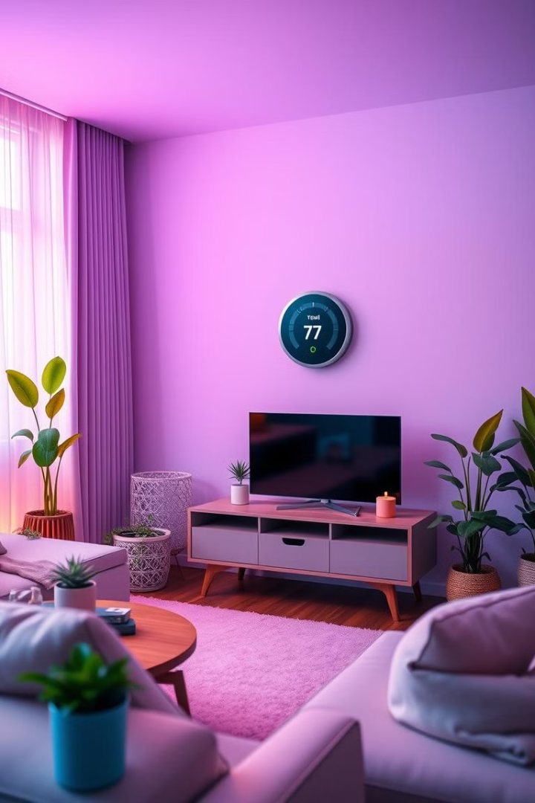
Smart Homes: Adaptive Thermostat System
This project introduces a smart thermostat system designed for energy optimization in residential settings.
Notes:
1

Slide 2
Team Details
S. JYOTHI
226N1A6148
M. CHAITHRIKA
226N1A6124
K. CHANDRA BHANU
226N1A6119
K. VEDA NANDHANA
226N1A6117
P. MOUNISHA
226N1A6138
G. SRUJANA
226N1A6109
S. KEERTHI SRI
226N1A6147
Notes:
2

Slide 3

Introduction to the Project
Problem
Benefits
Traditional thermostats lack adaptability, leading to inefficient energy use and wasted resources.
Reduce energy costs, promote sustainability, and enhance comfort levels.
1
2
3
Solution
A learning thermostat that analyzes user behavior and adjusts settings to minimize energy consumption.
Notes:
3

Slide 4
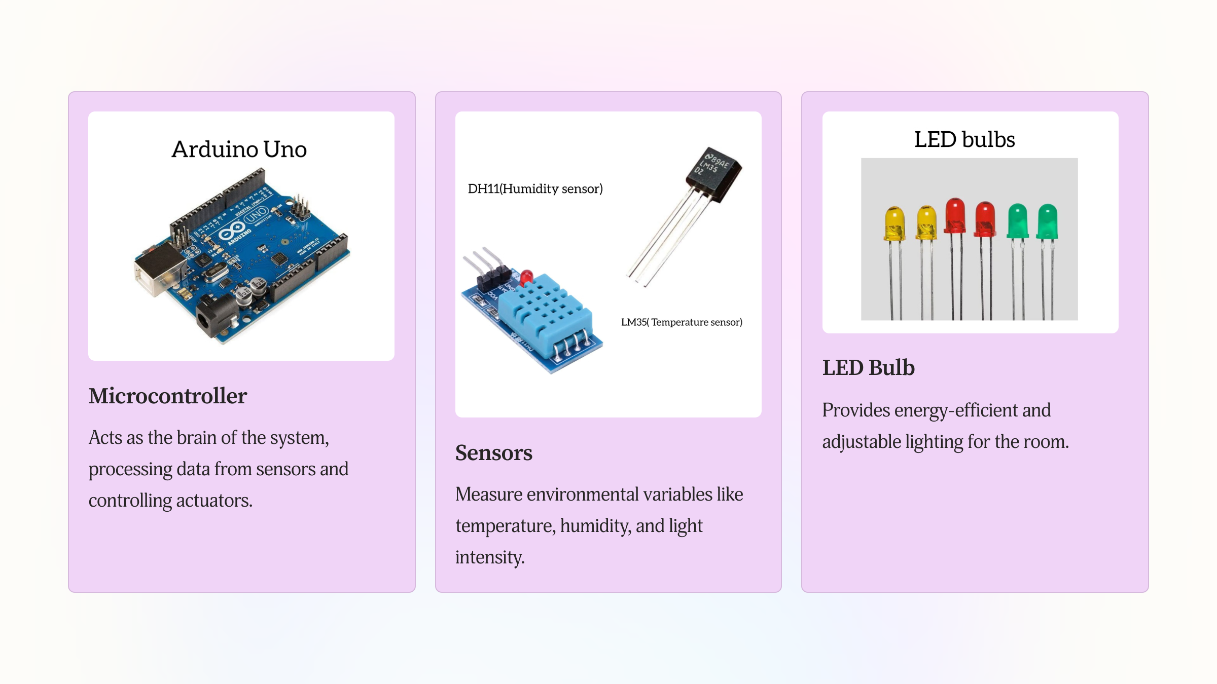
Hardware components
Notes:
7

Slide 5
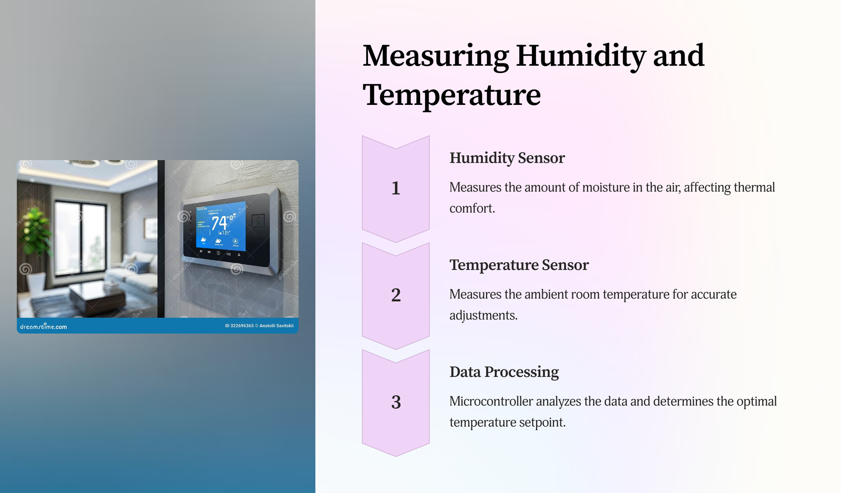

Slide 6
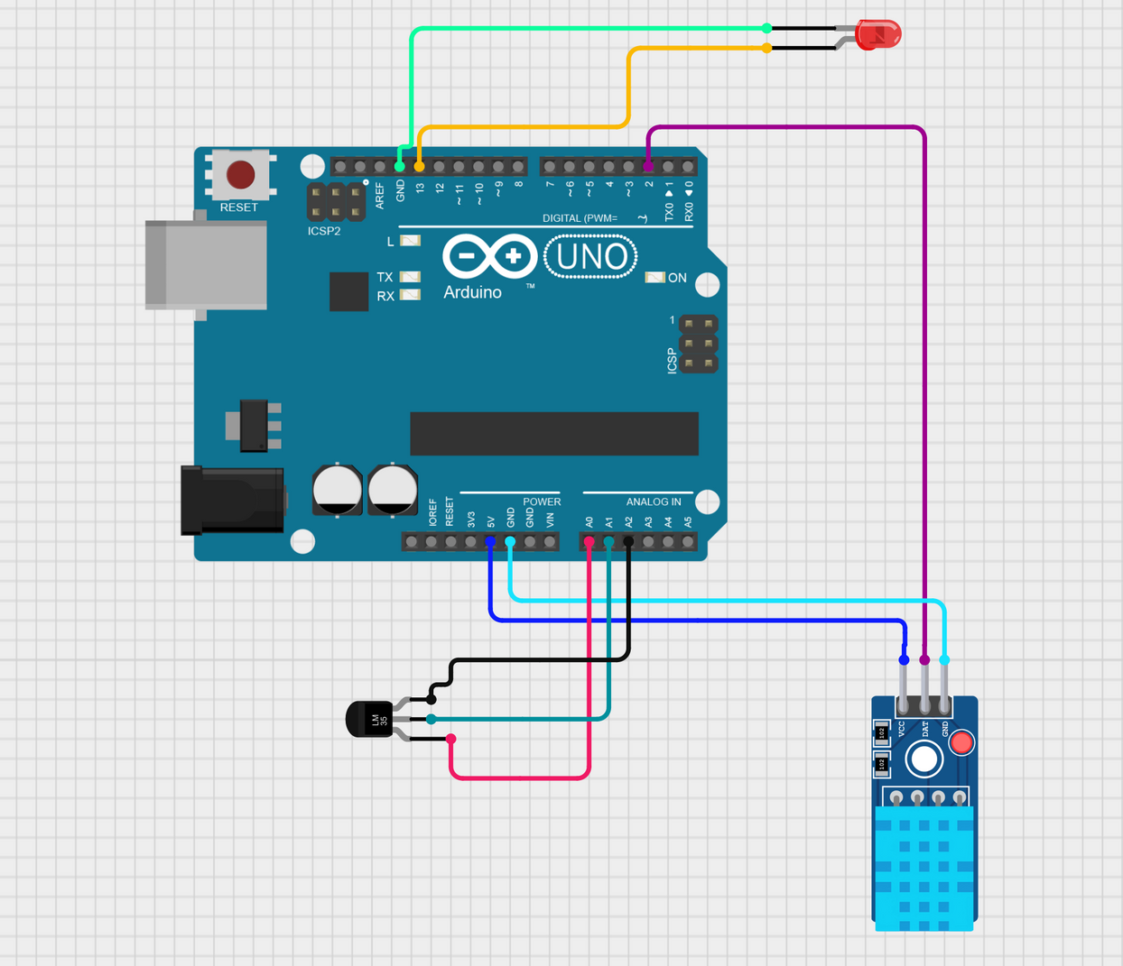
circuit diagram
Component
Description
Microcontroller
The brain of the system, controlling the overall operation.
Temperature Sensor
Measures room temperature
Humidity Sensor
Measures air moisture
Provides adjustable lighting
LED Bulb
Jumper Wires
It is used to quickly connect components in a circuit.
Notes:
5

Slide 7




Implementation
Software Development
Writing code for the microcontroller to process sensor data and control actuators.
Hardware Integration
Connecting and configuring the sensors and actuators to the microcontroller.
User Interface
Designing a user-friendly interface for controlling the system and viewing data
Notes:
6

Slide 8
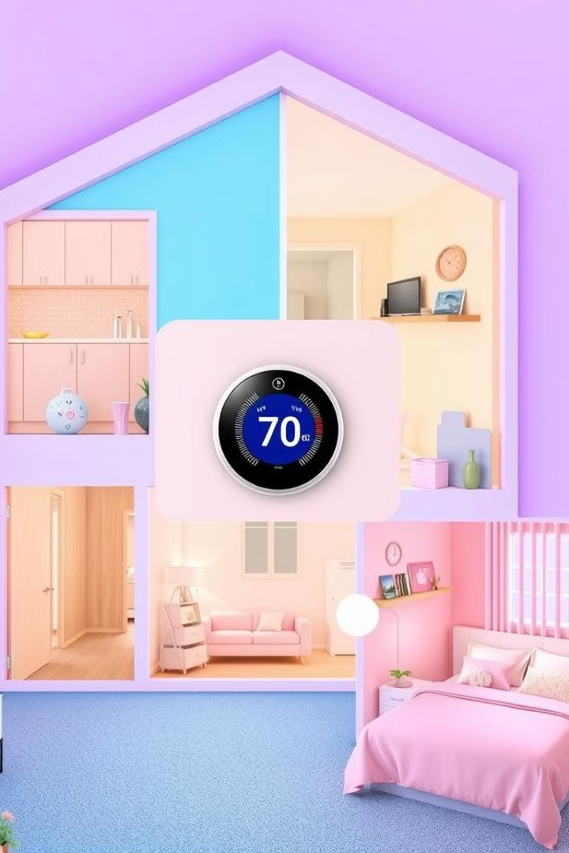
Applications
Residential Homes
Commercial Buildings
Optimize heating and cooling for individual households based on occupancy and preferences.
Improve energy efficiency in office spaces, hotels, or retail stores by adjusting temperatures based on usage patterns.
Smart Cities
Contribute to sustainable urban development by reducing overall energy consumption in buildings
Notes:
4

Slide 9

Conclusion
This smart thermostat system offers a promising approach to optimizing energy use in residential settings. By leveraging user behavior and machine learning, it provides a solution for both energy efficiency and enhanced comfort.
Notes:
8

Slide 10
THANK YOU
Notes:
9

